Slide 1



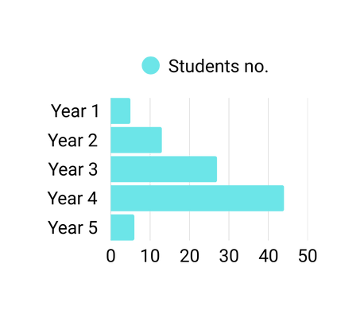

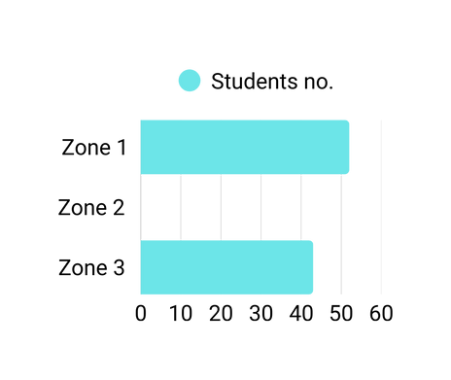
INTERCULTURAL IMMERSIVE EXCHANGE 2024-2025
Students applied: 129
Students got supported: 95
Pre-trip data: The students this year are highly motivated
Study years
1.
3.
Japan - 10
Malaysia - 1
Singapore - 6
S. Korea - 24
Sri Lanka - 1
Taipei - 1
Agency in different ratings
Intercultural awareness: 4.44/5
Language proficiency confidence: 4.14/5
Understanding of Sustainable Development Goals (SDGs): 4.31/5
News awareness: 4.25/5
Recognition of global citizenship importance: 4.44/5
Whole-person's mindset: 4.48/5
America - 2
Austria - 1
Berlin - 4
Brazil - 1
Canada - 3
Croatia - 3
Denmark - 5
France - 3
Germany - 12
Ireland - 3
Netherlands - 1
Poland - 1
Spain - 3
Tanzania - 1
UK - 9
Where did they go?
What do they mean?
The Intercultural Awareness items moved together the most strongly, meaning this theme is the most clearly defined pattern in students’ responses.

Slide 2
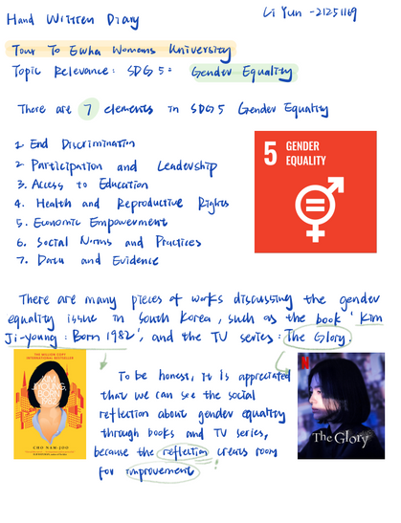

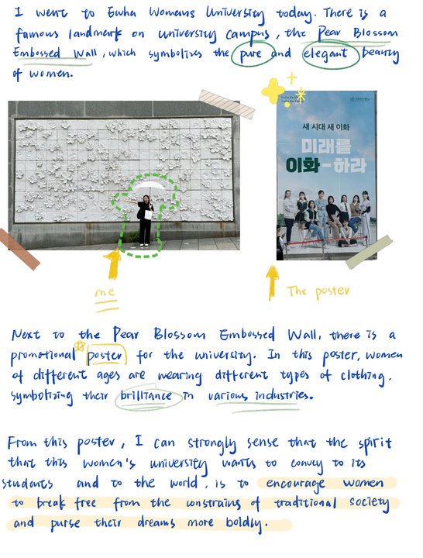

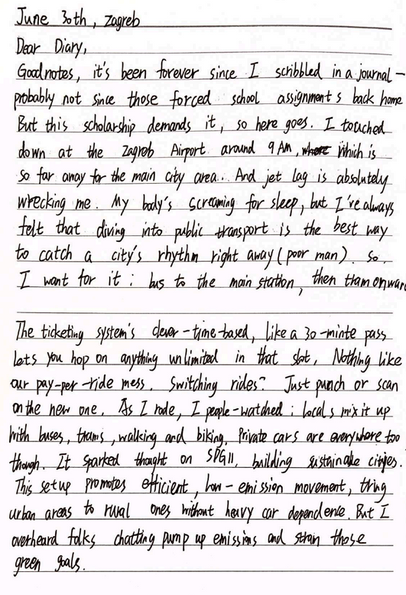
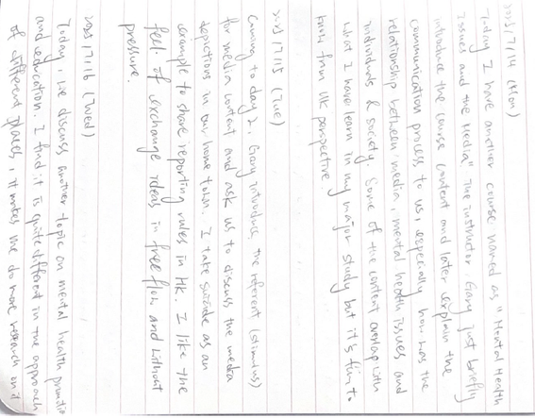
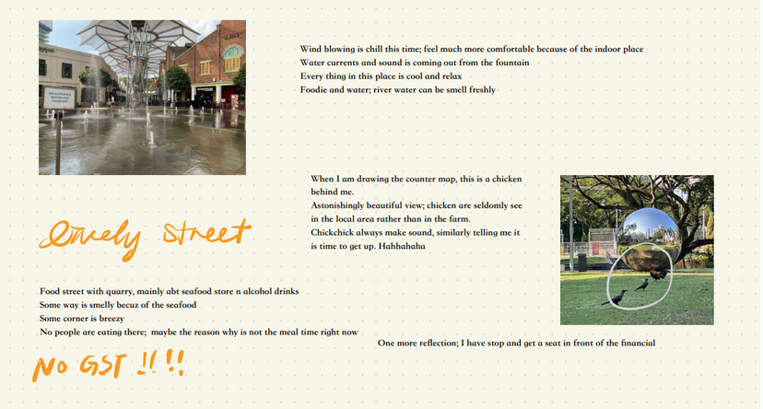
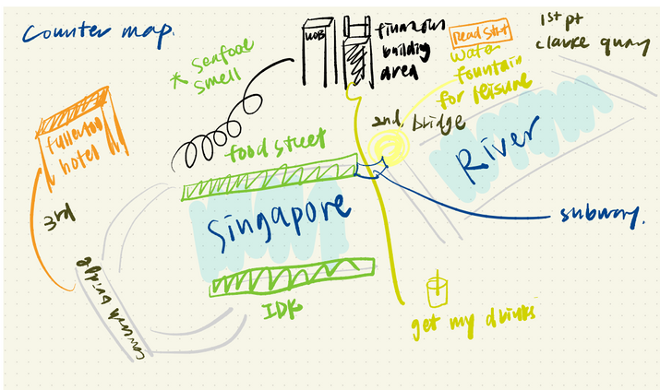
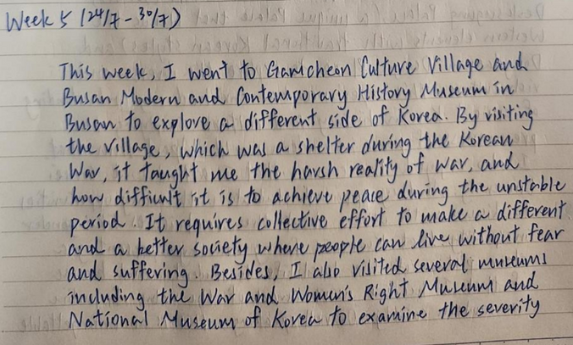
SAMPLE PRODUCTS

Slide 3
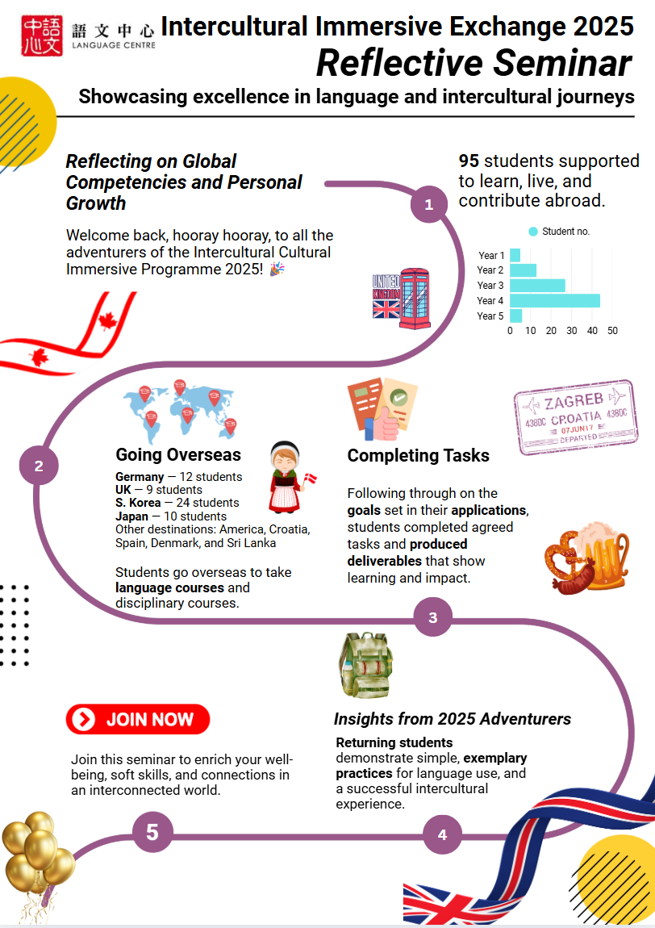

Slide 4
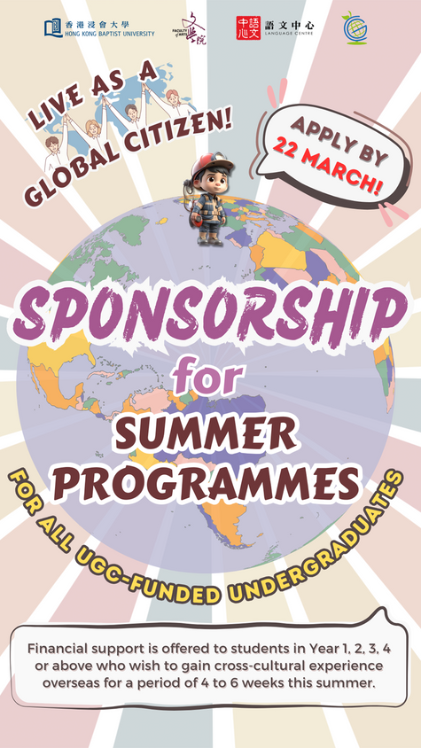
Learning for self-improvement
A greater commitment to civic engagement and global awareness.
Pre
Post
Enhanced confidence in dealing with cross-cultural situations
An awareness of global issues is important
Pre
Post
Community engagement is important
Increase in language proficiency and communication skills
Pre
Post
Not so important language skills
Post
Pre
Stronger understanding of SDGs
Introverted focus
Integrated focus o

Slide 5
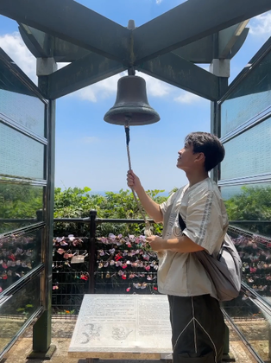
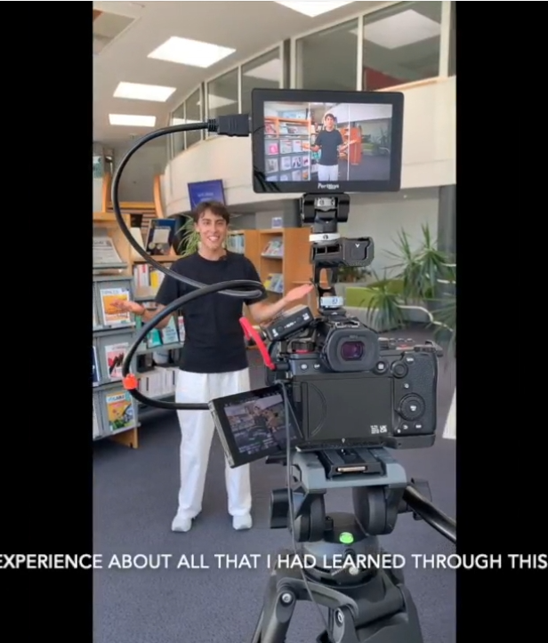
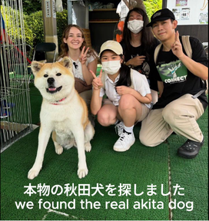

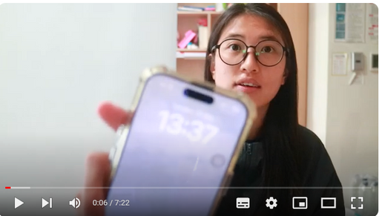

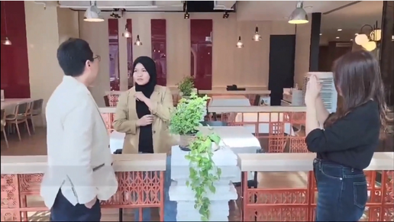
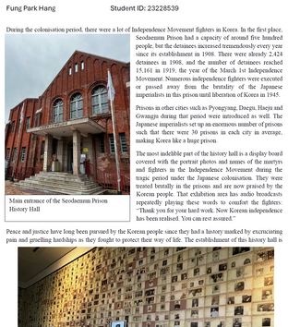
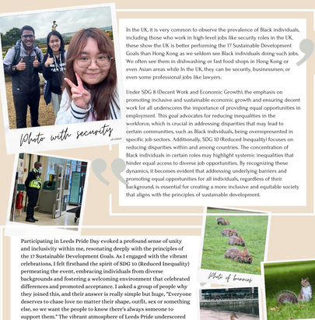
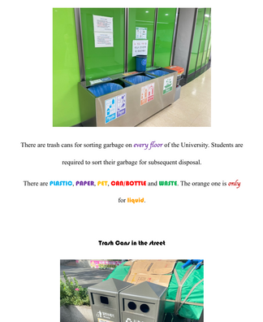
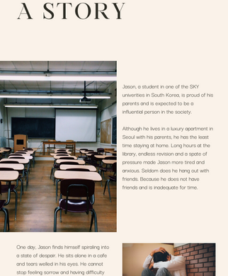
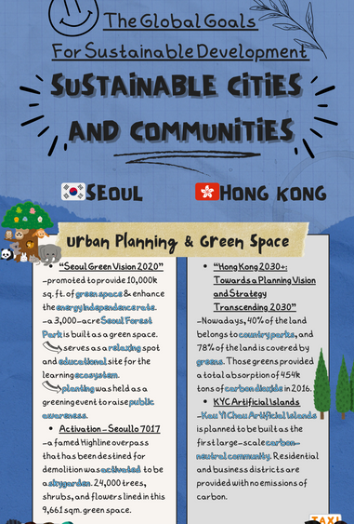
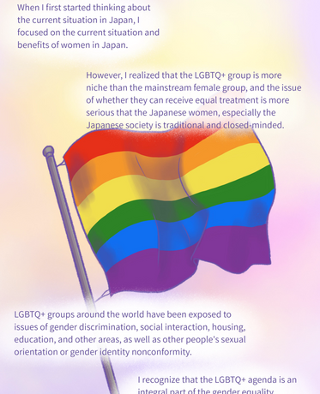
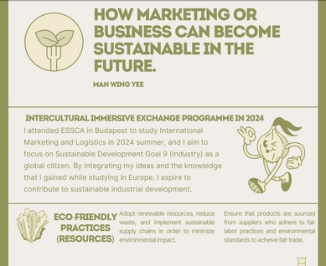
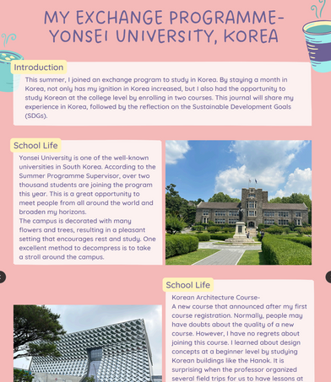
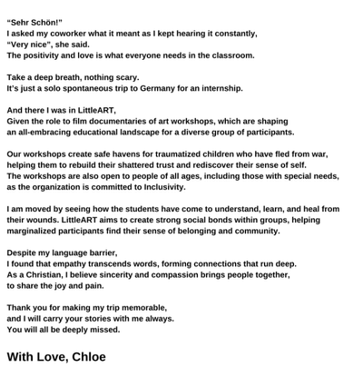
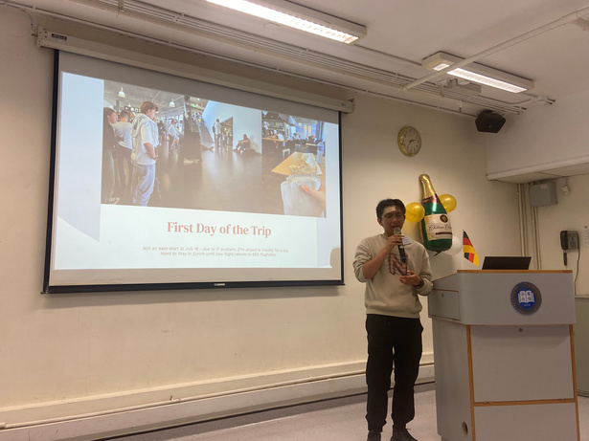
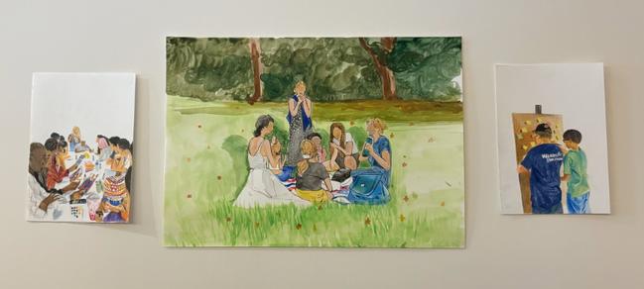
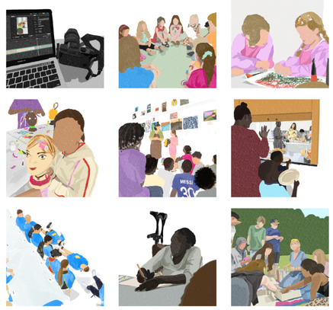
Students’ products after the summer programmes:
35 submissions of videos
25 submissions of photo journals and posters, as well as Instagram accounts
Other submissions include a novel and sketches with descriptions.

Slide 6

A Simple Method
1
On Environmental Responsibility:
2
On Gender Inequality
3
Engagement with Local Communities
During my time there, I engaged in various activities that enriched my understanding of resource management, particularly in the context of water management practices in both Chiang Rai and Rom Thai village in Chiang Mai.
"Witnessing firsthand how effectively Europe has protected and restored its coastal environments has really motivated me to advocate for similar conservation efforts back home."
"I realized that gender inequality is not just a South Korean issue; it is a global concern."
4
Witnessing Marine Conservation Efforts
5
Exploring Fast Fashion's Impact in Japan
6
Community Clean-Up in Singapore
5
A Simple Method
2
“I was encouraged to see the innovative ways people are working to conserve and restore marine life... From community-led mangrove rehabilitation projects to sustainable aquaculture initiatives.”
“As I learned more about the environmental issues tied to fast fashion—such as textile waste and carbon emissions—I felt a growing sense of responsibility."
"One pivotal moment was participating in a community clean-up event, where locals came together to maintain public spaces."

